Slide 1
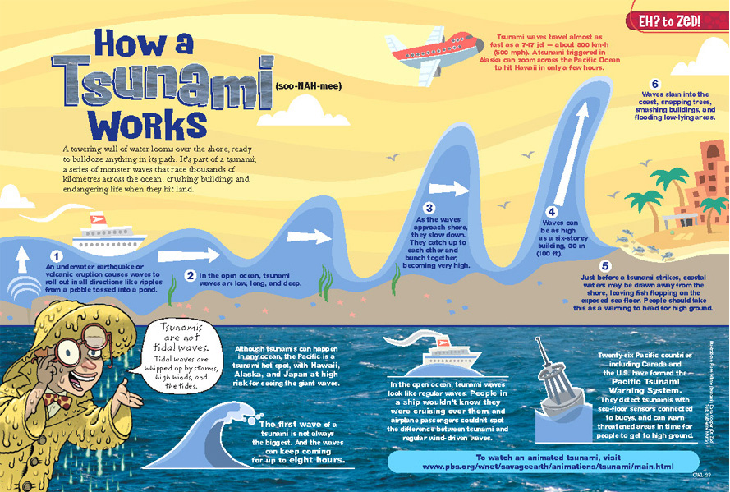
MAPPING THE PAGE
A Strategy for Helping to
Navigate Nonlinear Text
This image is from OWL MAGAZINE and used with permission of Owlkids,
a division of Bayard Canada. www.Owlkids.com.

Slide 2
This image is from OWL MAGAZINE and used with permission of Owlkids, a division of Bayard Canada. www.Owlkids.com.

Slide 3
Traditional text is considered to be linear; in other words, the reading path is determined by the writer, usually top to bottom and left to right.
Most visual texts, such as infographics, are nonlinear. The information, both print and pictures, are scattered all over the page and it is up to the reader to determine the order in which the information is read.
Too often, readers miss key information because they simply overlook bits of information on the page, such as captions or vocabulary supports.
High Interest Publishing
HIP-books.com

Slide 4
Start by circling the title. It tells what the passage is about. What other information do you see along with the title?
(Pronunciation Key)
This image is from OWL MAGAZINE and used with permission of Owlkids, a division of Bayard Canada. www.Owlkids.com.

Slide 5
Look for an introductory paragraph. It gives an overview of the key information. Circle it.
This image is from OWL MAGAZINE and used with permission of Owlkids, a division of Bayard Canada. www.Owlkids.com.

Slide 6
Where is the key information about how a tsunami works? Put a box around it.
Notice that it’s numbered. What number is missing? Why is it separate from the others?
This image is from OWL MAGAZINE and used with permission of Owlkids,
a division of Bayard Canada. www.Owlkids.com.

Slide 7
Where else can you find chunks of interesting (but not as important?) information about tsunamis? Box them.
This image is from OWL MAGAZINE and used with permission of Owlkids, a division of Bayard Canada. www.Owlkids.com.

Slide 8
Have you missed anything?
What about the speech bubble?
What about the information next to the plane?
This image is from OWL MAGAZINE and used with permission
of Owlkids, a division of Bayard Canada. www.Owlkids.com.

Slide 9
What extra information does the blue box at the bottom provide?
This image is from OWL MAGAZINE and used with permission of Owlkids, a division of Bayard Canada. www.Owlkids.com.

Slide 10
This image is from OWL MAGAZINE and used with permission of Owlkids, a division of Bayard Canada. www.Owlkids.com.

Slide 11
Does this help you remember the information?

